Slide 1








kelompok bahasa inggris
Tugas Presentasi
by kelompok 4

Slide 2

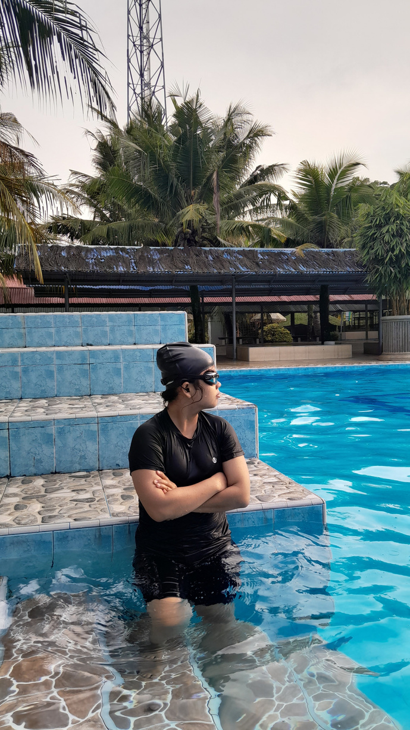
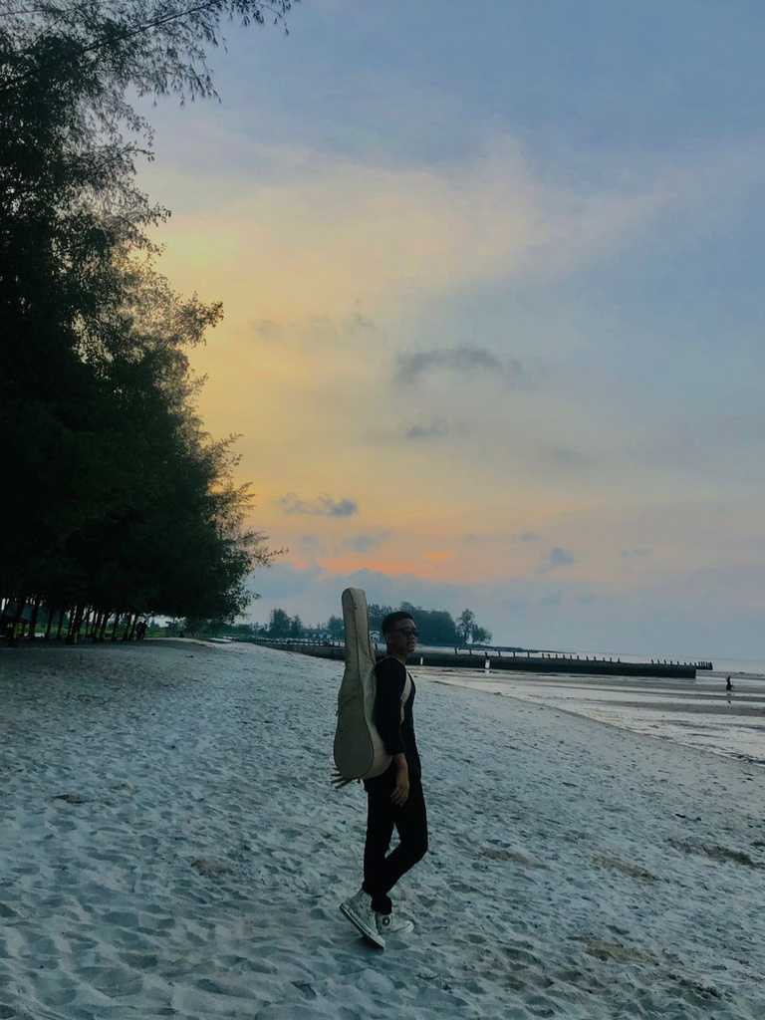

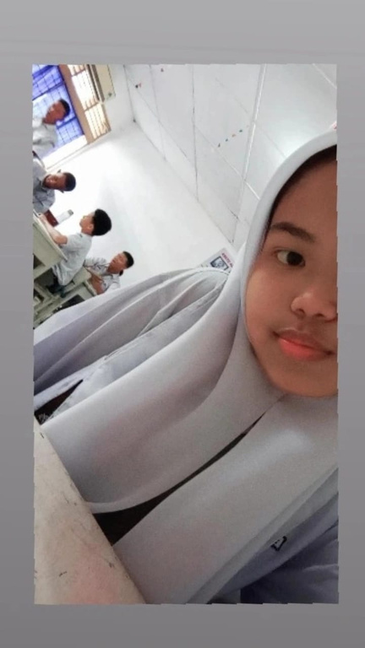
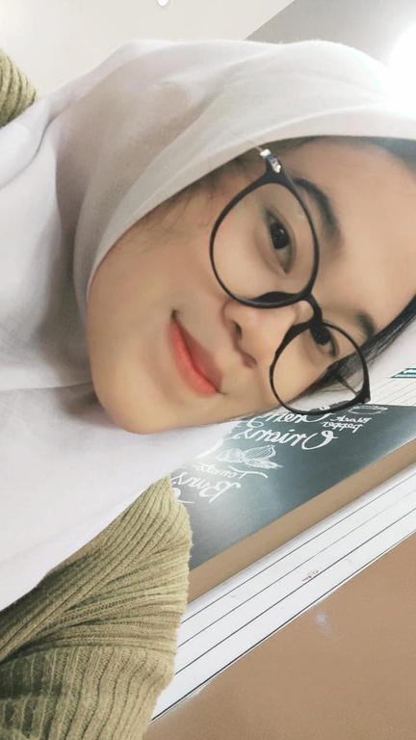


kelompok
4
Sani
dewa
Zalfa
ayu

Slide 3
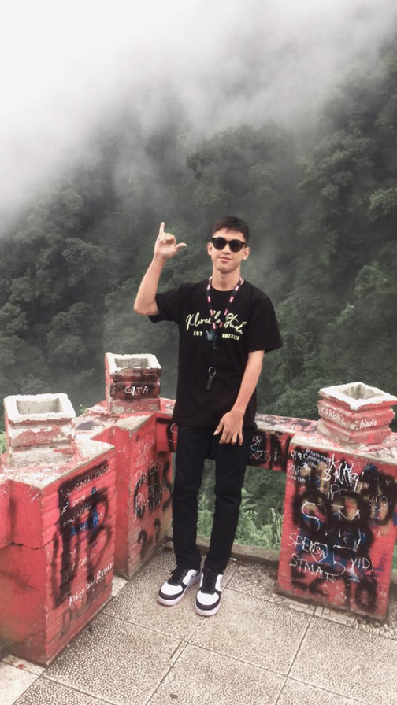

revan
Silvia

Slide 4

identification
M Syahdewa pane
being on the beach and watching the sunset

Slide 5

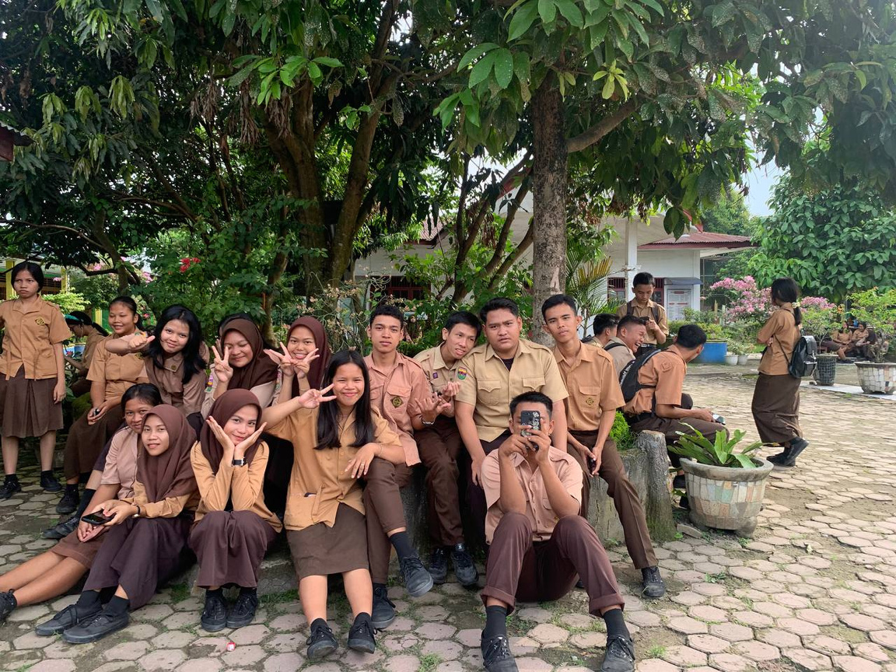


Group Caption
-Sani is a member of class Xll-ips4
- Ruth is a member of class Xll-ips4
-Sekar is a member of class Xll-ips4
-Nur is a member of class Xll-ips4
-Aisyi is a member of class Xll-ips4
-Zalfa treasurer class Xll-ips4
-Irma secretary class Xll-ips4
-Dedi is a member of class Xll-ips4
-Yohanes is a member of class Xll-ips4
-Alfiansyah is a member of class Xll-ips4
-Kiki head of class Xll-ips4
Abdul is a member of class Xll-ips4

Slide 6

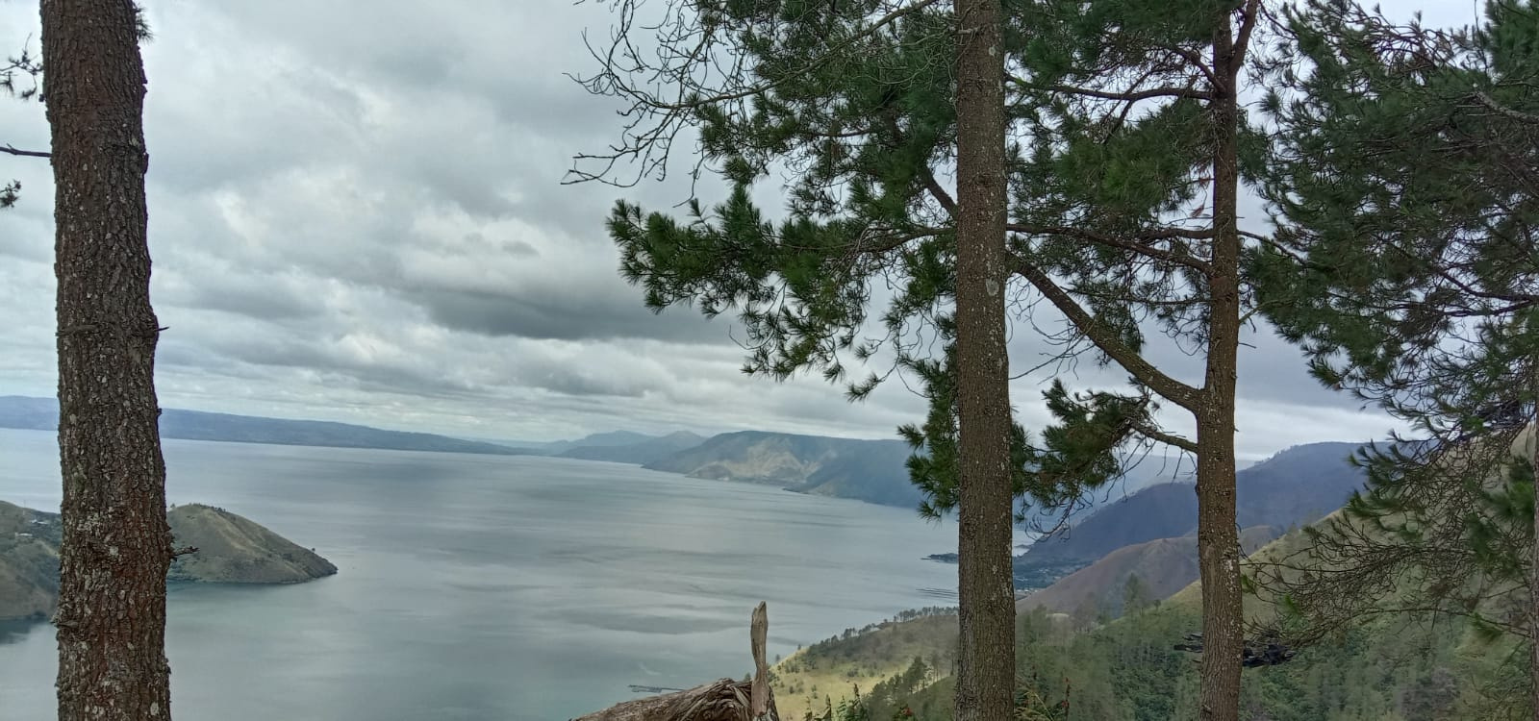
Story-Tealling Caption
Lake Toba is heaven on earth because of its beautiful views and cool air

Slide 7


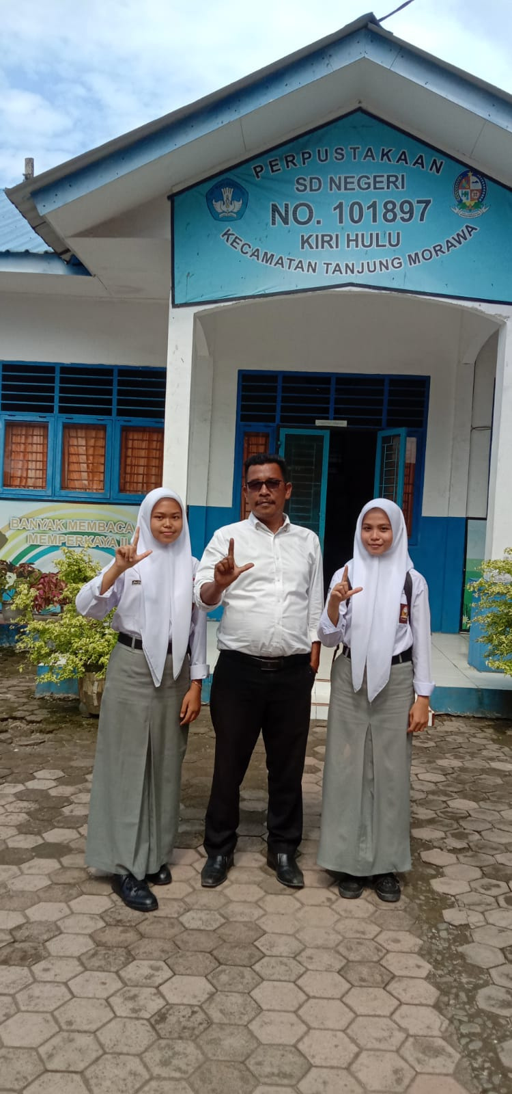


Summary
Zalfa and Aisyi met the deputy principal at SD 101897 Kiri Hulu Bandar Labuhan to carry out observations on history assignments
Day/date: Saturday 11 April 2023
Time : 12.00

Slide 8
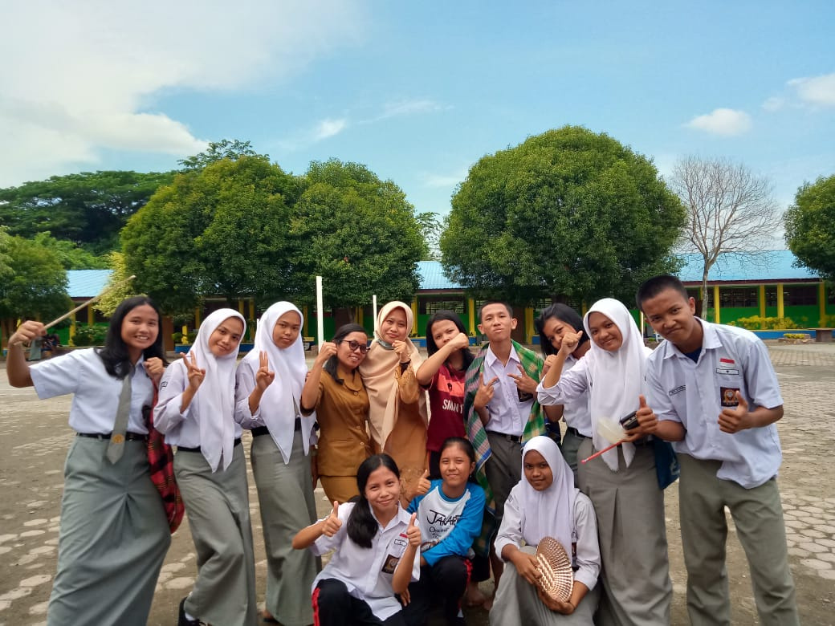

Quote
Enjoy what you have and feel right now, because behind a beautiful story and journey there must be a difficult challenge and you managed to overcome it.

Slide 9
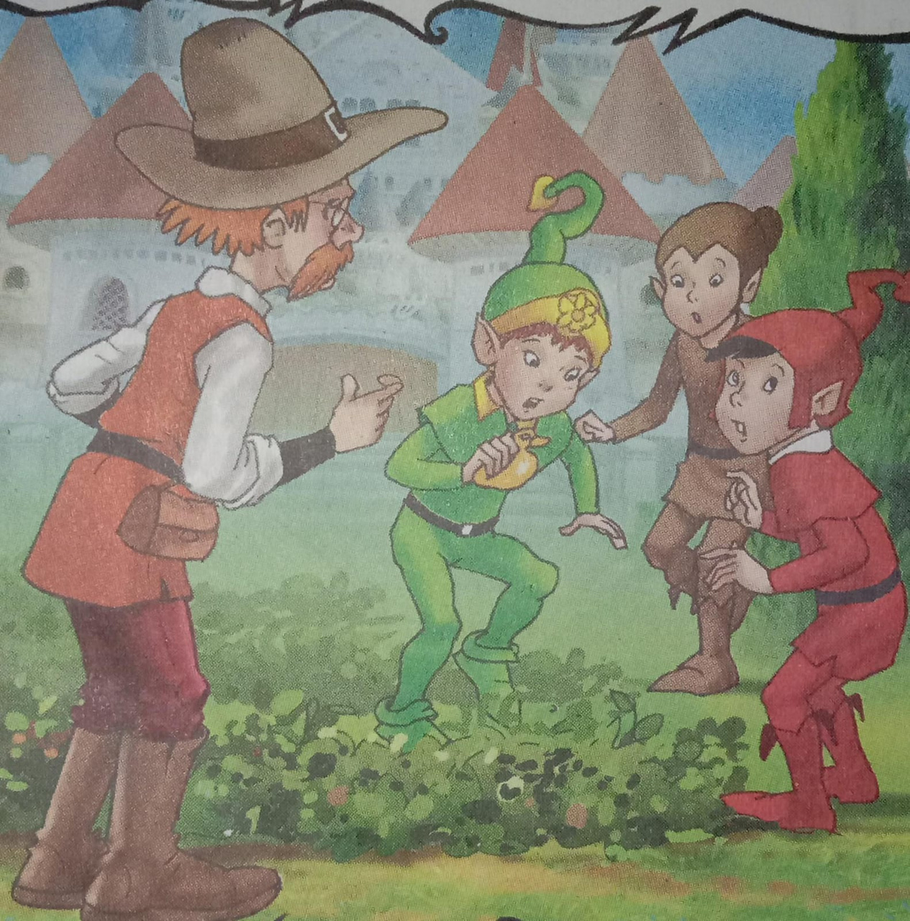
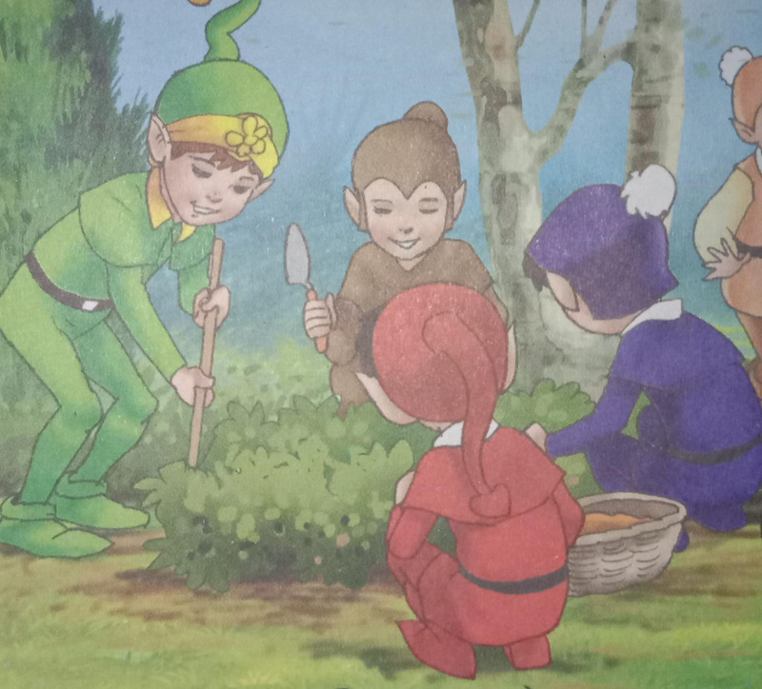
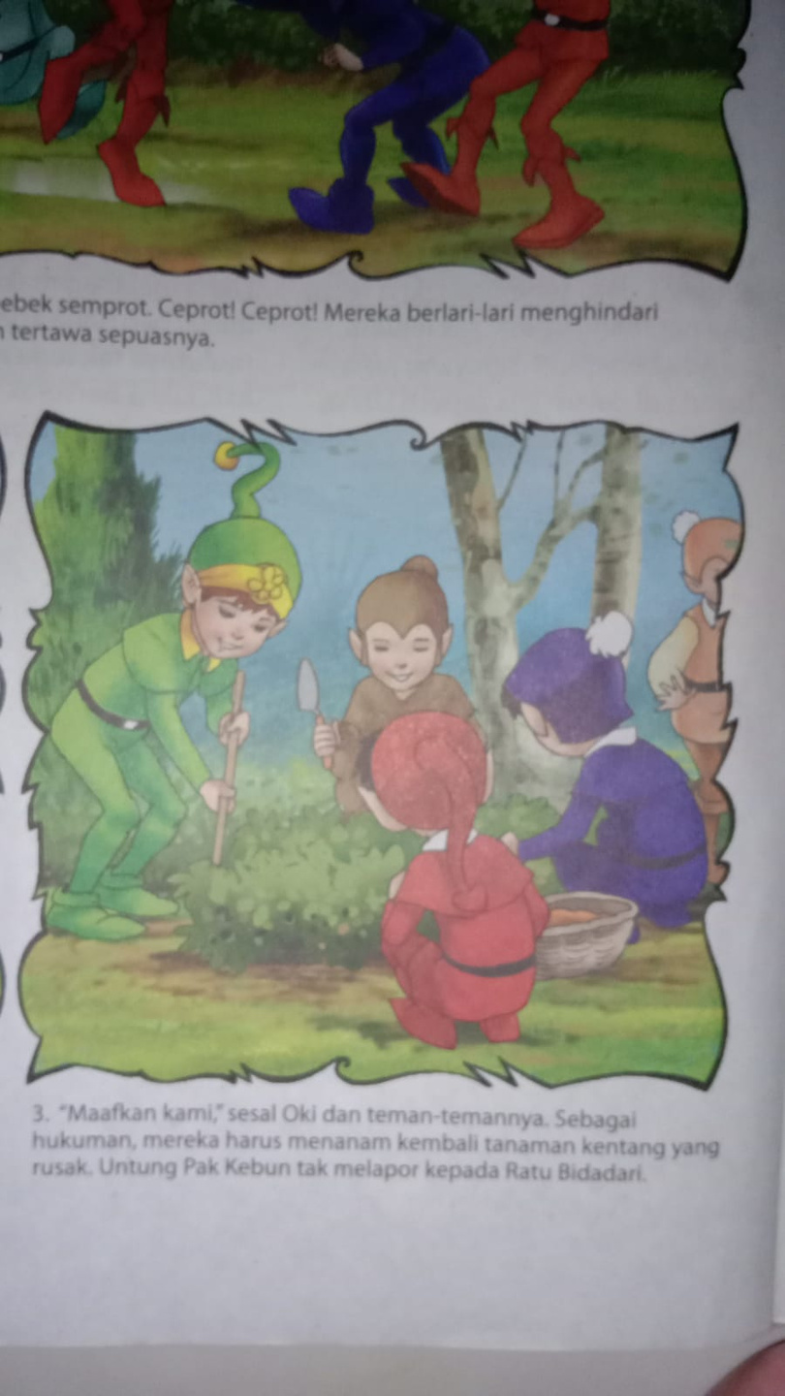
Cutline
Oki and the dwarves played with spraying water using spray duck toys. splash! splash! They ran around avoiding the spray from the opponent's ducks. the most exciting thing is, they can scream and laugh as much as they want.

Slide 10
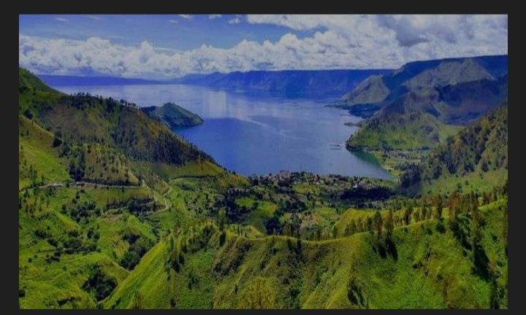
expanded
The origin of Lake Toba was formed as a result of volcanic eruptions located in the North Sumatra province of Indonesia. Lake Toba is a famous tourist attraction abroad because of its amazing beauty

Slide 11

Terimakasih

